Slide 1

Project Title
Solving the N-Queens Problem
Submitted By:
Preksha Ruhela 202410116100148
Nikhil 202410116100132
Priyakant Tyagi 202410116100151
MCA 1st year (Sec-C)
Notes:
Hello everyone! We are [your names], and today we’ll talk about the N-Queens Problem.
It’s a puzzle where we place queens on a chessboard without them attacking each other.
But it’s more than just a game—it’s used in AI, scheduling, and solving tricky problems.
We’ll explain how it works in a simple way.
Let’s begin!

Slide 2
Introduction
The N-Queens problem is a fundamental challenge in combinatorial optimization. It involves placing N queens on an N x N chessboard in such a way that no two queens attack each other.
Why is this important?
• Used in AI, optimization problems, and game theory.
• Demonstrates recursive backtracking principles.
• Applied in scheduling, circuit design, and resource allocation.
Notes:
The N-Queens problem is an important challenge in discrete optimization. It’s widely used in AI, game theory, and solving real-world problems like scheduling and circuit design. The problem also demonstrates recursive backtracking, a key technique in computer science for finding efficient solutions.

Slide 3
Problem Definition
The goal is to place N queens on an N x N chessboard.
Constraints:
No two queens can share the same row.
No two queens can share the same column.
No two queens can share the same diagonal.
Example:
For N = 4, one possible solution is:
[0, 1, 0, 0]
[0, 0, 0, 1]
[1, 0, 0, 0]
[0, 0, 1, 0]
Notes:
The N-Queens problem requires placing N queens on an N x N chessboard while ensuring no two queens share the same row, column, or diagonal. The challenge is to find valid placements that satisfy these constraints.
For example, a possible solution for N = 4 is shown as a matrix representation.

Slide 4
Why Backtracking?
The problem has an exponential number of possible solutions.
Brute-force checking is inefficient for larger N values.
Backtracking systematically explores valid queen placements while eliminating incorrect placements early.
Process:
Start with an empty board.
Place queens row by row.
If a conflict arises, backtrack and try a different placement.
Repeat until a valid solution is found.
Notes:
The N-Queens problem has an exponential number of solutions, making brute-force checking inefficient.
Backtracking optimizes the process by systematically placing queens row by row while eliminating invalid placements early.
If conflicts arise, the algorithm backtracks to find a valid solution efficiently.
(Explain the process)

Slide 5
Step-by-Step Algorithm
1. Initialize an N x N board with all cells set to 0.
2. Define the isSafe() function to check if a queen can be placed at a given position.
3. Use a recursive function solveNQUtil() to:
4. Place a queen in the first available row of a column.
5. Move to the next column and repeat.
6. If a column has no valid placement, backtrack to the previous column and adjust.
7. If all queens are placed successfully, print the board.
8. If a solution is found, visualize it using matplotlib.
Notes:
"Pehle board ko 0 se initialize karte hain. isSafe() check karta hai queen safe hai ya nahi. solveNQUtil() se queens ko row by row place karte hain. Agar kahin conflict ho, toh backtrack karte hain. Solution milne par board print aur matplotlib se visualize karte hain."

Slide 6
Code Implementation (Python)
The algorithm is implemented in Python using recursion and backtracking.
Key functions:
isSafe(): Checks if a position is valid.
solveNQUtil(): Implements the backtracking logic.
visualizeBoard(): Displays the chessboard with placed queens.
Code snippet:
def isSafe(board, row, col, N):
for i in range(col):
if board[row][i] == 1:
return False
return True
Notes:
"Ye algorithm Python mein recursion aur backtracking se banaya gaya hai. isSafe() position check karta hai, solveNQUtil() queens ko place karta hai, aur visualizeBoard() board ko show karta hai."

Slide 7
Time Complexity Analysis
The number of possible arrangements grows exponentially with N.
Worst-case complexity: O(N!) due to factorial growth.
Optimizations can reduce time complexity:
Pruning invalid positions early.
Using heuristics like Most Constrained Variable (MCV).
Notes:
*"Jab N badhta hai, toh possible queen arrangements bahut tezi se (exponentially) badhne lagte hain. Worst-case mein iska time complexity O(N!) hota hai, jo kaafi slow hota hai. Isliye time bachaane ke liye kuch optimizations use kiye ja sakte hain — jaise invalid positions ko early hi hata dena (pruning), aur smart techniques

Slide 8
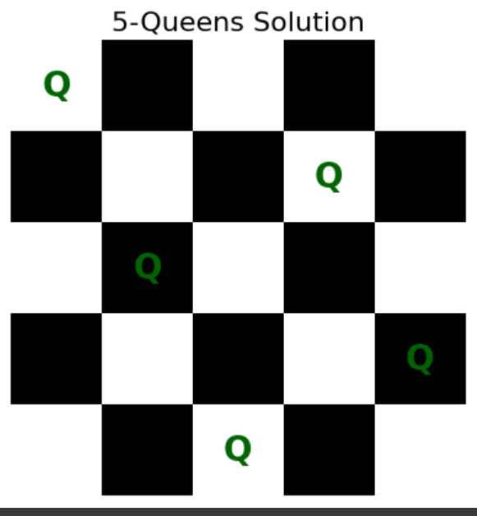
Visualization of the Solution
The solution is displayed using a chessboard visualization.
Matplotlib is used to represent valid queen placements graphically.
Example for N = 5:
The board is color-coded with queens marked in green.
Shows safe placement of all queens.
Notes:
Solution ko chessboard ke visual form mein dikhaya gaya hai. Matplotlib ka use karke queens ke placements ko graphically show kiya gaya hai. N = 5 ke example mein, board color-coded hai aur green se queens ko mark kiya gaya hai. Yeh dikhata hai ki saari queens safe position par placed hain."

Slide 9
Real-World Applications
Although initially a puzzle, the N-Queens problem has applications in:
Robotics: Optimizing robot movements.
AI and Machine Learning: Constraint satisfaction problems.
Parallel Processing: Task scheduling and register allocation.
Game Development: AI-based game strategies.
Notes:
"N-Queens shuruaat mein ek puzzle tha, lekin iska use kaafi fields mein hota hai: Robotics mein robot ke movements optimize karne ke liye, AI/ML mein constraint satisfaction problems solve karne ke liye, Parallel processing mein task scheduling ke liye, aur game development mein smart AI strategies banane ke liye."

Slide 10
Challenges and Future Scope
Challenges:
High computational cost for large N values.
Memory limitations when solving large board sizes.
Future Improvements:
Implementing heuristic-based approaches.
Using parallel computing to improve efficiency.
Exploring alternative AI techniques for faster solutions.
Notes:
"Bade N ke liye problem solve karna slow ho jata hai aur memory bhi zyada lagti hai. Isko improve karne ke liye future mein heuristic methods, parallel computing, aur AI techniques jaise genetic algorithm use kiye ja sakte hain taaki solution fast mile."

Slide 11
Conclusion
The N-Queens problem is an excellent example of backtracking and constraint satisfaction.
Our implementation efficiently finds valid solutions for small to medium values of N.
Future optimizations can improve performance for larger values.
Key takeaways:
Backtracking is a powerful algorithmic technique.
Visualization enhances understanding.
Problem-solving skills learned can be applied to real-world challenges.
Notes:
N-Queens problem backtracking aur constraint satisfaction ka best example hai. Hamari approach small to medium N ke liye solutions easily find karti hai. Future mein optimizations se large N ke liye performance better ho sakti hai. Backtracking powerful technique hai, visualization se samajh aur clear hoti hai, aur jo problem-solving skills hum seekhte hain, wo real-world problems mein kaam aati hain."

Slide 12
Thank You!
Notes:
That’s all about the N-Queens problem! Thank you

